Slide 1
Artificial intelligence in breast imaging: Current situation and clinical challenges
Source: https://www.ncbi.nlm.nih.gov/pmc/articles/PMC10582610/

Slide 2
Breast Cancer:
According to the latest global cancer burden data released by the International Agency for Research on Cancer of the World Health Organization in 2020, breast cancer has the highest morbidity and mortality of all cancers worldwide.
Breast imaging significantly contributes to breast cancer management to reduce mortality.

Slide 3
Challenges in Breast Cancer Diagnosis and Imaging
Breast cancer is a complex disease arising from the mammary epithelium.
There are different types of breast cancer, and they behave differently. Some are more serious than others, have higher chances of coming back after treatment, spread to other parts of the body, and respond differently to chemotherapy.
Currently, doctors mainly rely on their own knowledge and experience to assess breast tumors, which can lead to different decisions about how to treat patients.
Radiologists, who are doctors specialized in reading medical images like X-rays and MRIs, feel overwhelmed by the huge amounts of images they must look at every day, which leads to job burnouts.

Slide 4
The Role of Artificial Intelligence in Breast Imaging
In recent years, artificial intelligence (AI), particularly driven by deep learning (DL) and convolutional neural networks (CNNs), has become prominent in medical imaging, offering solutions to challenges in breast imaging.
AI is well-suited for handling repetitive tasks and large volumes of data, thereby enhancing the efficiency of breast imaging and image interpretation

Slide 5
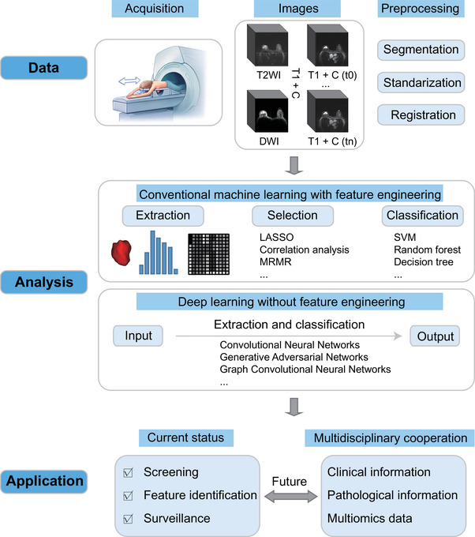

Slide 6
Breast Imaging Database
Developing AI-assisted detection and diagnosis systems for breast cancer requires extensive data.
AI leverages massive datasets, integrating clinical, pathological, and genetic information to construct a comprehensive multidisciplinary system for diagnosing and treating breast cancer.
The Cancer Imaging Archive (TCIA), funded by the National Cancer Institute (NCI), is the largest open-access imaging database globally.
TCIA hosts 45 cancer imaging collections, with breast cancer being the most prominent, featuring 18 public collections.
While TCIA primarily includes data from European and American patients, it has limited representation from Asian patients.
The TCIA-Breast dataset comprises four modalities: mammography (MG), magnetic resonance imaging (MRI), computed tomography (CT), and positron emission tomography (PET).
MG and MRI are the most important scans because they're used the most and have the most cases.

Slide 7
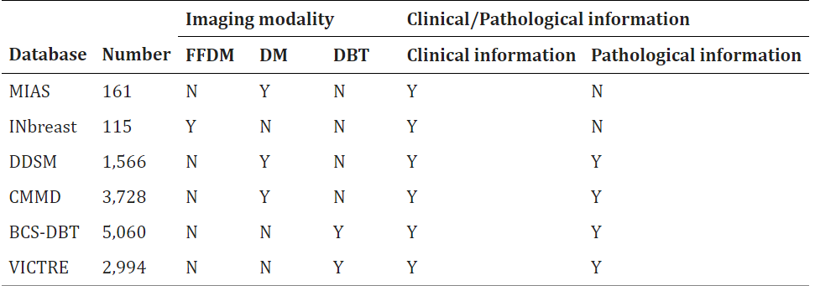
Publicly Available Mammography Datasets:

Slide 8
MIAS: Contains images of 161 patients, focusing on digital medial lateral oblique (MLO) views, with some additional clinical and pathological information.
INbreast: Features images of 115 participants, providing both full-field digital mammography (FFDM) and clinical information, including Breast Imaging Reporting and Data System (BI-RADS) classification.
DDSM: This dataset includes over 10,000 images from 1,566 participants, mainly focusing on digital mammography (DM) with additional information for developing computer-aided diagnostic systems.

Slide 9
CMMD: Comprising over 3,700 images from Chinese patients, CMMD is the only dataset representing Asian populations and is primarily used for training DL models.
BCS-DBT: With over 22,000 images from 5,060 participants, this dataset focuses on digital breast tomosynthesis (DBT) and was used in a competition to evaluate AI software for breast lesion detection.
VICTRE: Released by the FDA, this dataset contains over 200,000 images from nearly 3,000 subjects and is used to evaluate DBT as a substitute for DM, providing valuable insights for regulatory evaluation.

Slide 10
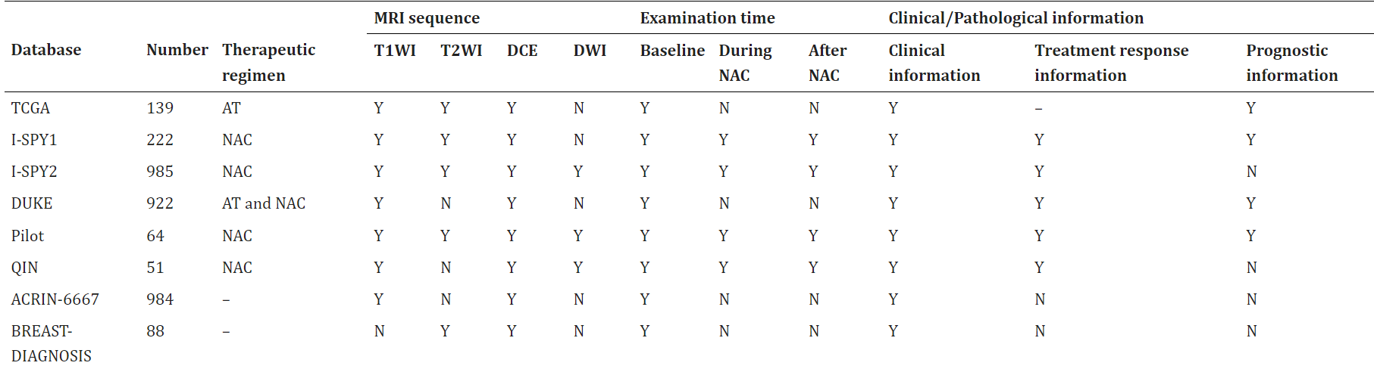
Publicly Available Breast MRI Datasets

Slide 11
TCGA: This dataset includes MRI images from 139 breast cancer patients undergoing adjuvant therapy, providing a comprehensive view of imaging, clinical, pathological, and genetic information.
I-SPY1 and I-SPY2: Derived from large-scale trials, these datasets contain MRI images from patients receiving neoadjuvant chemotherapy (NAC), aiming to predict treatment response and recurrence risk.
DUKE: Comprising baseline MRI images of 922 patients with invasive breast cancer, this dataset offers detailed clinical, pathological, and prognostic information.
Pilot and QIN: These datasets include patients undergoing NAC, providing multiple MRI examinations and additional imaging modalities like PET/CT.
ACRIN-6667 and BREAST-DIAGNOSIS: These datasets offer MRI images of patients with unilateral breast cancer and various lesion types, contributing valuable data for research and diagnosis.

Slide 12
Application of Deep Learning Algorithms

Slide 13
1. Flow of Breast Image Processing and Analysis:
Data Acquisition: Involves obtaining images through mammography (MG), ultrasound (US), and MRI.
Image Preprocessing: Includes tasks like breast image registration and segmentation.
Mining Image Information: Involves analyzing and predicting using different modalities for detection and classification.
CNNs in Action: CNNs (Convolutional Neural Networks) are the backbone of deep learning architectures for breast image processing.
CNN Components: A typical CNN comprises an input layer, convolution layer, pooling layer, fully connected layer, and output layer.
Diverse Algorithms: Transformer models, Generative Adversarial Networks (GANs), and Graph Convolutional Neural Networks (GCNs) are increasingly utilized for breast image analysis.

Slide 14
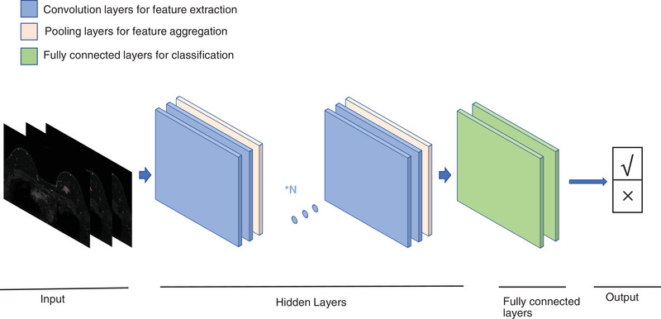

Slide 15
2. Application of DL Algorithms in Breast Image Segmentation:
Automatic Segmentation: DL algorithms enable seamless segmentation of breast tumors in images, aiding in precise diagnosis and treatment planning.
Popular Segmentation Models: We utilize advanced models like V-Net, U-Net, SegNet, and cGAN, each designed to tackle specific segmentation challenges.
U-Net's Versatility: U-Net stands out for its effectiveness in blending low- and high-resolution image features, making it a cornerstone in medical image segmentation.
U-Net with Transformer Models: By integrating U-Net with transformer models, we harness the power of convolution and self-attention strategies, significantly improving segmentation accuracy.
Innovative cGAN Segmentation: Vivek et al. introduced a cutting-edge segmentation model based on cGAN, leveraging generative and adversarial networks to achieve precise tumor detection and segmentation.

Slide 16
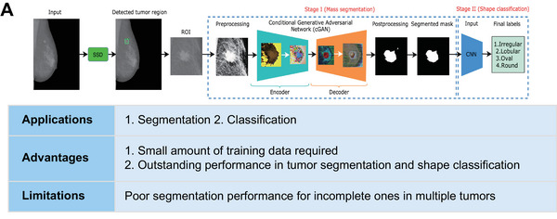


Slide 19
Challenges in Breast Tumor Segmentation:
Segmentation Challenges: Segmentation of breast tumors poses difficulties due to blurred borders and the need to differentiate between various lesion types.

Slide 20
3. Application of DL Algorithms in Breast Image Detection and Classification:
Primary Focus: Breast imaging analysis mainly revolves around detecting abnormalities and classifying them accurately, which DL algorithms excel at.
Detection Models: YOLO and ROI-CNN are commonly used for detecting breast masses, offering high accuracy and efficiency.
Classification Models: Models like GoogLeNet, AlexNet, ResNet, VGG, and YOLO are employed for precise classification of breast lesions, aiding in treatment planning.
Challenges: Challenges like model limitations and the "black box" problem still persist.

Slide 21
4. Application of DL Algorithms in Sample Labeling:
Challenges: Limited availability of high-quality labeled data presents a significant obstacle in medical imaging AI studies, compounded by high labeling costs and small sample sizes in breast imaging.
Weakly Supervised Learning Methods: Researchers have devised weakly supervised learning approaches to tackle these challenges by combining weakly annotated datasets with small strongly annotated datasets.
Benefits: Weakly supervised learning methods offer advantages such as reduced training costs and improved accuracy, making them invaluable in scenarios with limited labeled data.

Slide 22
Status of Clinical Research

Slide 23
1. Screening:
Mammography (MG) with AI: AI enhances MG examinations by improving breast cancer detection sensitivity, reducing recalls and biopsies, and decreasing interpretation time.
Large-scale MG data-based AI models significantly improve lesion detection, aiding radiologists in diagnosis with enhanced efficacy.
DL models combined with clinical factors achieve high accuracy in predicting microcalcifications, surpassing junior radiologists’ performance.
AI systems assist in preselecting screening items, reducing radiologists' workload without compromising diagnostic accuracy.

Slide 24
1. Screening:
Breast Ultrasound (US) and MRI: DL-based CAD systems enhance screening accuracy and efficiency, particularly in dense breast tissue.
Automated diagnosis models based on DL improve the efficiency and reliability of breast cancer screening by identifying malignant tumors and solid nodules.
CAD systems optimize the efficacy of MRI in detecting and segmenting nonmass-enhanced lesions, reducing false-positive rates.

Slide 25
2. Feature Identification:
Differential Diagnosis: AI models, especially CNNs, excel in distinguishing benign and malignant lesions and identifying molecular subtypes of breast cancer.
Combining multimodal imaging data improves prediction accuracy of molecular subtypes.
Machine learning models differentiate breast cancer subtypes accurately, aiding in treatment decisions.

Slide 26
2. Feature Identification:
Axillary Lymph Node Prediction: DL models predict lymph node metastasis with high sensitivity and specificity, guiding appropriate treatment strategies.
Multiomic signatures incorporate radiomic features and clinical characteristics, identifying patients with axillary lymph node metastasis preoperatively.

Slide 27
3. Surveillance:
Efficacy Prediction: DL radiomics models predict response to neoadjuvant chemotherapy (NAC) accurately, aiding in treatment planning.
AI algorithms track tumor changes over time, predicting disease-free survival and overall survival rates.

Slide 28
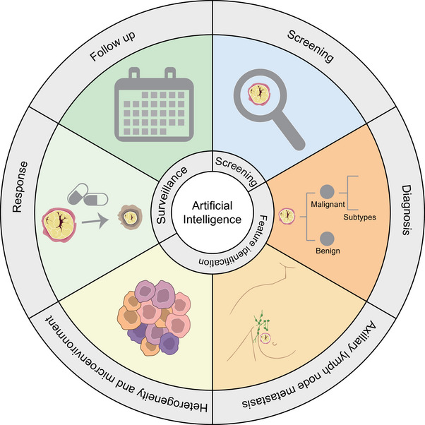
Current status of research on AI imaging in clinical applications of breast cancer:

Slide 29
Problems and Challenges of AI in Breast Imaging
Standardized Database: Current datasets like CMMD are limited in scale and source diversity.
Transparency of AI Algorithms: The "black box" issue of AI algorithms hampers medical decision-making confidence and AI's sustainable development.

Slide 30
THANK YOU

